Slide 1
Predicting Myocardial infarction complications
By: Lennox Garay

Slide 2
Agenda
The problem
Eda
The models
What is MI?
Relevant physiology.
Variable names/explanation
Explain covariates and response variables
Data Visualization
Variable selection philosophy
Use of classification models
Detail model performance
Conclusions

Slide 3
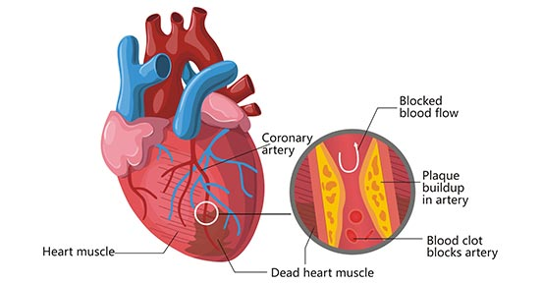
What is a myocardial infarction?
Basically, a heart attack
Caused by a blockage of blood flow to the myocardium (muscular tissue of the heart).
Prolonged blockage may cause necrosis of myocardium and brain tissue (hypoxia)
Can go undetected
May not instantly cause death but complications may arise

Slide 4
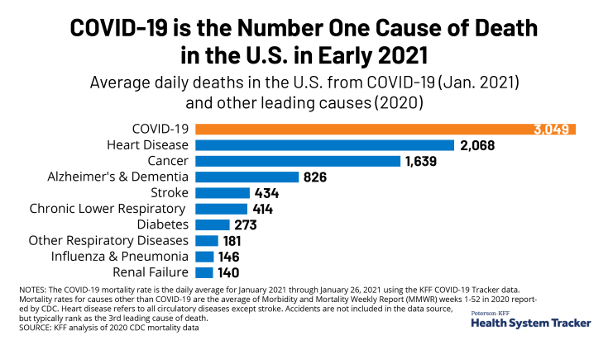
The problem
Even though the introduction of modern treatment and prophylactic measures has somewhat reduced mortality from heart attacks, it continues to be quite high. Every year in the United States 200-300 thousand people die from acute myocardial infarction before arriving at the hospital [1]. In the United States, every 29 seconds, one person becomes ill with MI, and every minute one patient with MI dies. (Griffin, B.P., et. al, 2008)

Slide 5
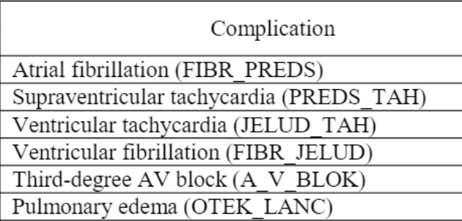
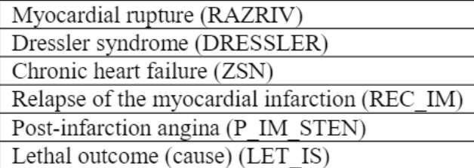
Complications from mi
Variables in parenthesis are in the data file used for analysis. These are the response variables for prediction.
Notes:
Fibrillation and Tachycardia are essentially the heart beating fast. Atrial fibrillation specifically refers to the unusual/arhythmic beating. Supraventricular tachycardia refers to beating faster than normal.
Third-degree AV BLOCK is a serious condition. It occurs when there is a complete lack of communication between atria. The electrical impulses from the top of the heart do not reach the bottom part of the heart. This can prevent blood from reaching the heart and brain.
Dressler syndrome is inflammation of the sac surrounding the heart (pericarditis). Its an immune response to myocardial damage as a result from heart attack, surgery, or other traumatic injury.

Slide 6
Some acknowledgements and limitations
Didn’t check whether data is non-linearly separable
Imputed NA values with median
Limited visualizations due to sheer volume of data.
Covariates have multiple levels, keeping track of all of them becomes messy.
MCA/PCA for visualization may be useful (could show density plot)
Bias-Variance tradeoff. Some models are probably overfit, especially XGBoost.

Slide 7
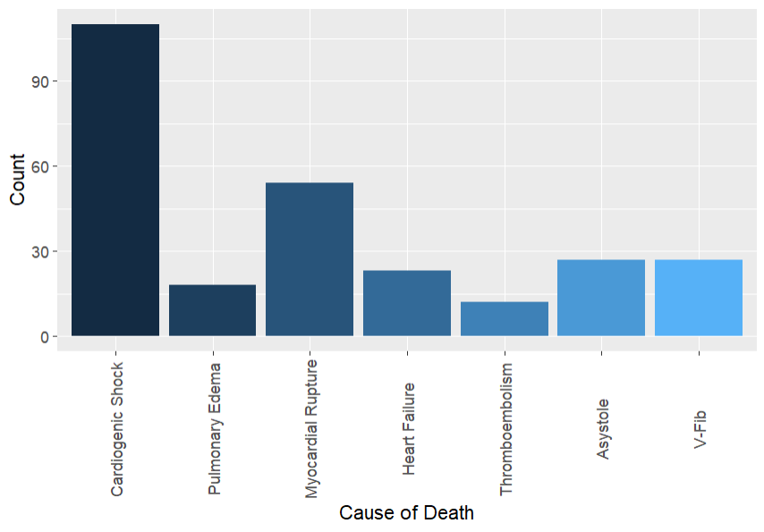
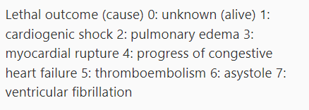
The data
1700 observations of patients who were admitted to a hospital in Krasnoyarsk Russia for MI.
111 covariates, 12 response variables.
All covariates are used, which according to the data is an analysis of patient outcomes after 3 days in the hospital.

Slide 8
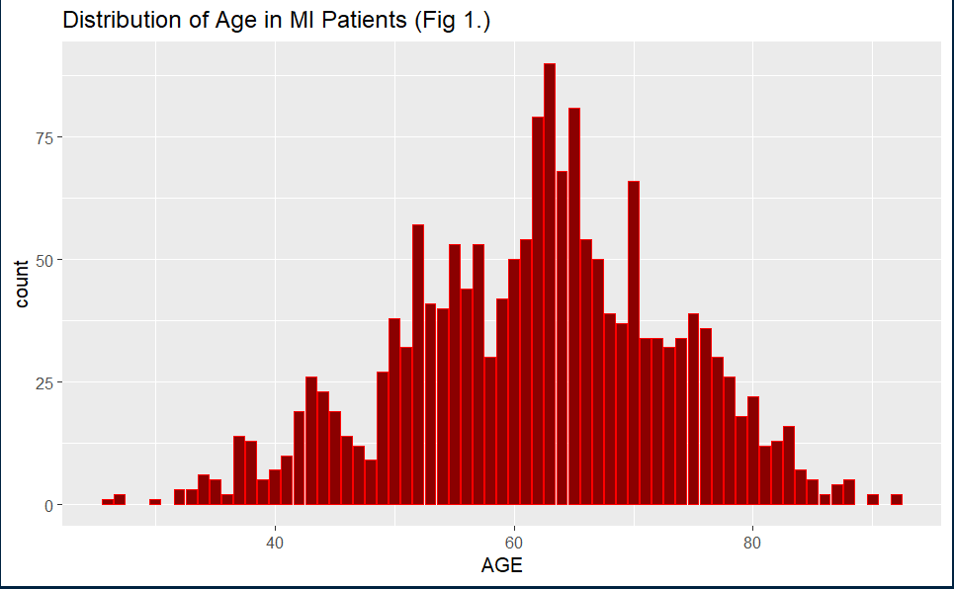
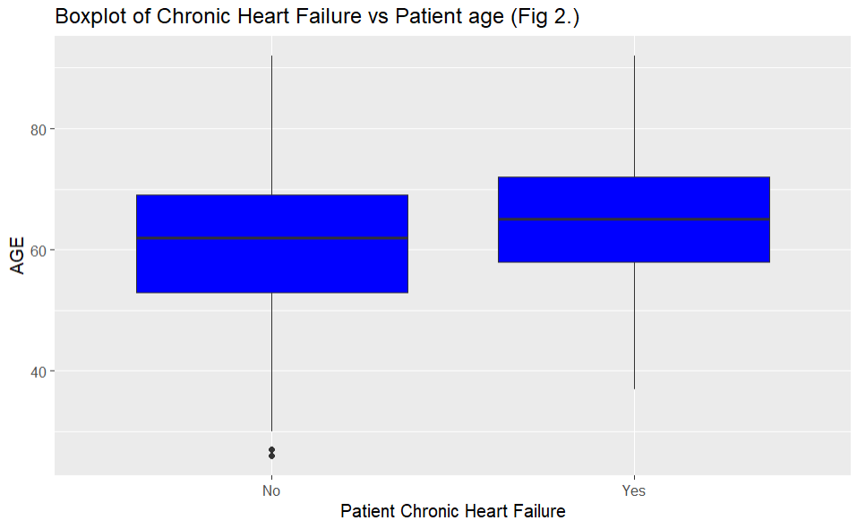
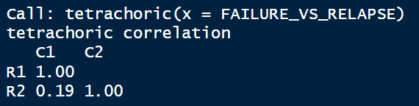
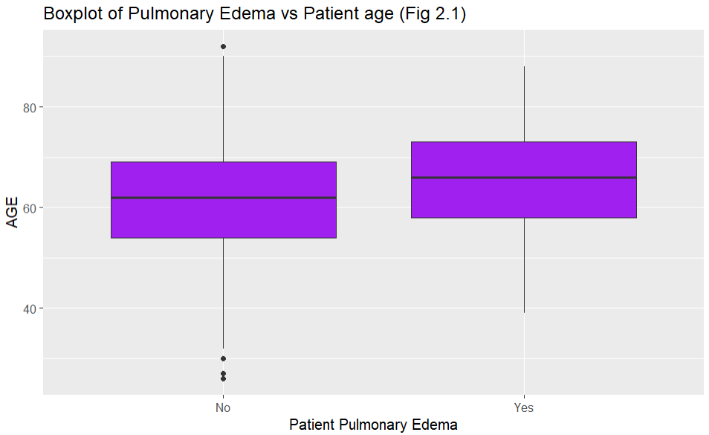
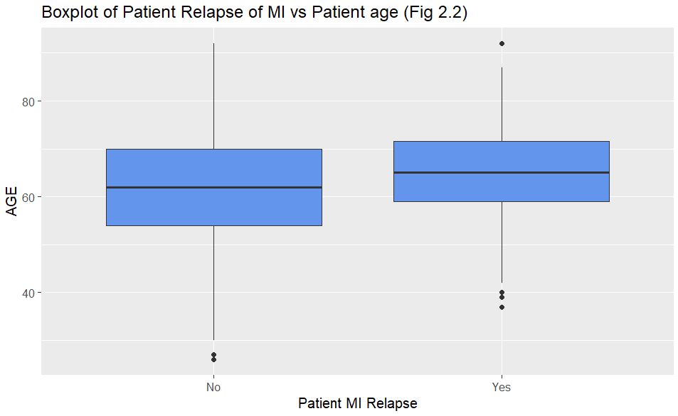
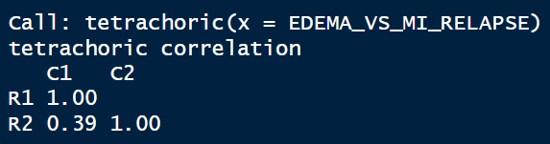
The data
24% occurrence rate
9.35% occurrence rate
9.35% occurrence rate

Slide 9
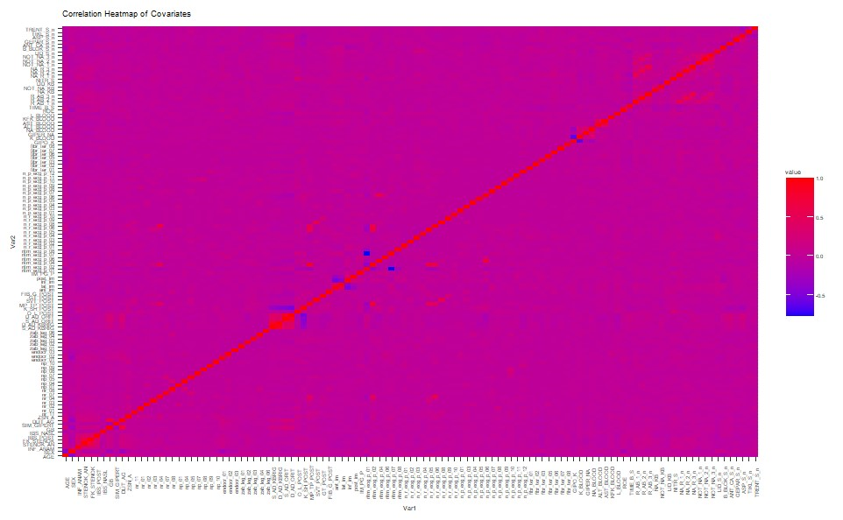

Slide 10
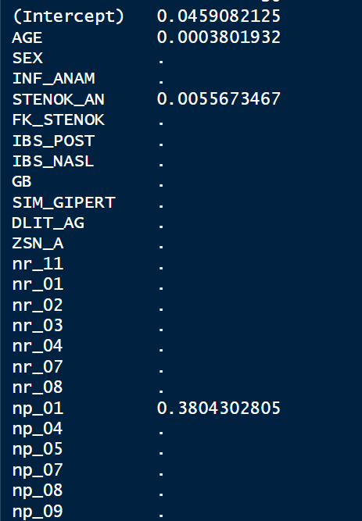
Variable selection
How do we pick variables for selection?
Could use LASSO but here its not very good!
We used all the variable as suggested by the institution that collected the data
It would be interesting to do the analysis without LASSO-eliminated covariates

Slide 11
the goal of models
Trying to predict response variables using covariates including patient history (e.g., ZSN_A).
This amounts to classification. Binary classification in most cases but python can handle multiclass prediction automatically.
For example, XGBoost defaults to a logistic object parameter when it detects 2 layers and defaults to softmax when it detects data frames have more than 2 layers.
The models used for classification include:
Logistic Regression:
XGBoostClassifier:
KNN: For laughs
Decision Tree:
Linear SVM: Limited to binary classification
RBF SVM: Investigates non-linear separability of the data

Slide 12
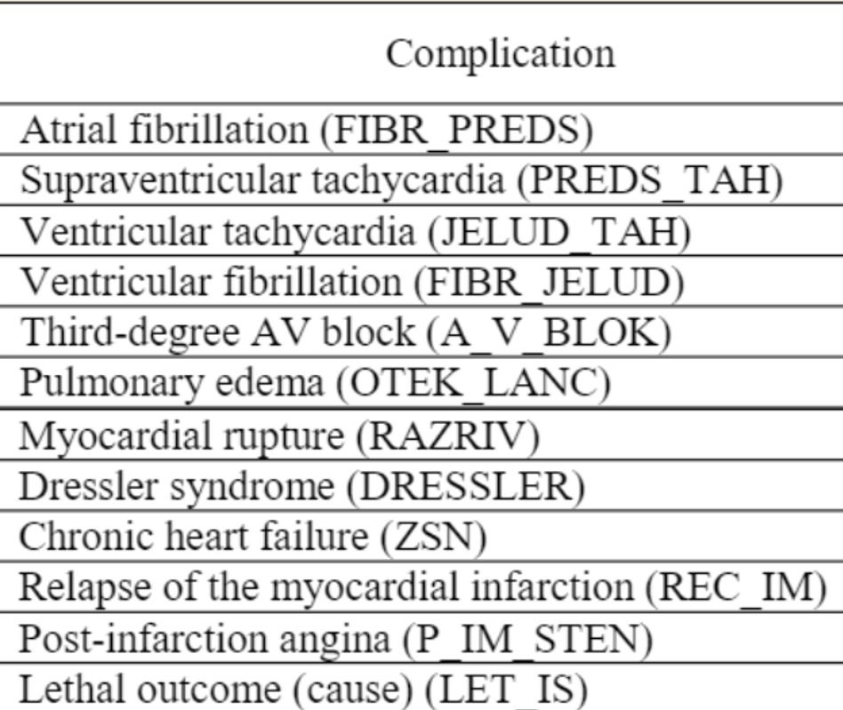
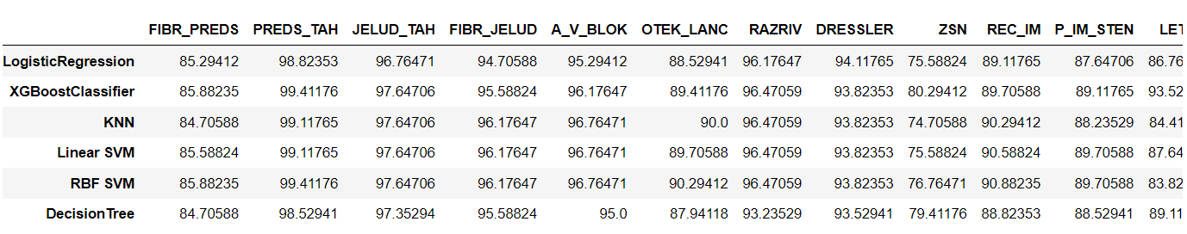
Running the models
In this data frame the (i,k) element represents the accuracy of model i predicting response variable k.
Note: Virtually nobody had Supraventricular tachycardia

Slide 13
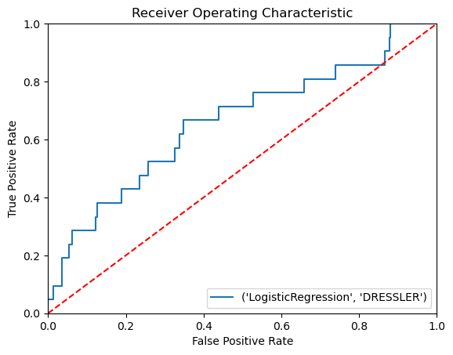
Logistic regression
Logistic regression was the best at predicting Dressler Syndrome.

Slide 14
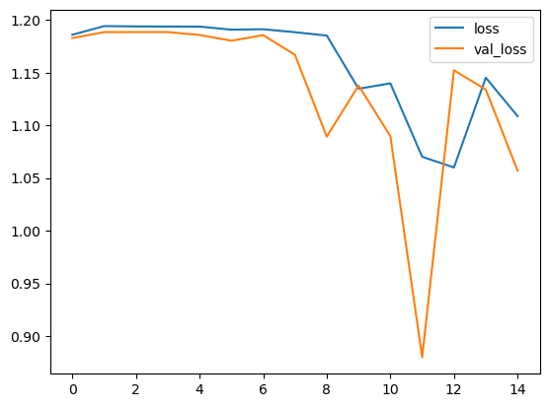
Neural network
Not great. Something definitely went wrong
In the coding of this I tried to do all the variables at
Once and clearly that did not work out for me.
If I had more time, I would give this a better treatment, but I opted to do SVM and XGB instead.
Just thought I would at least mention it, even if the
Results are virtually useless.

Slide 15
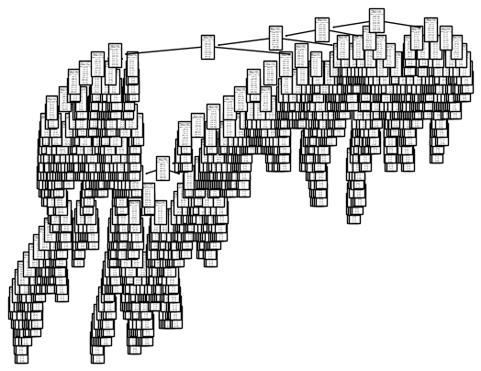
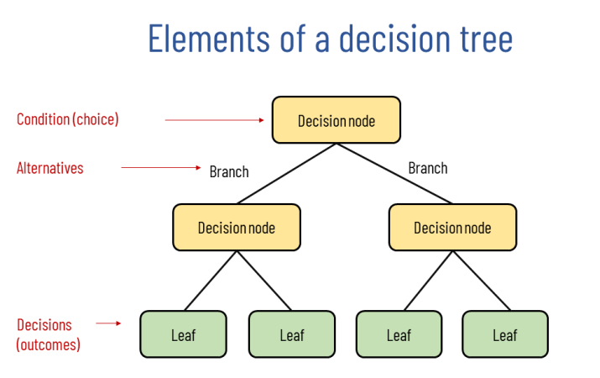
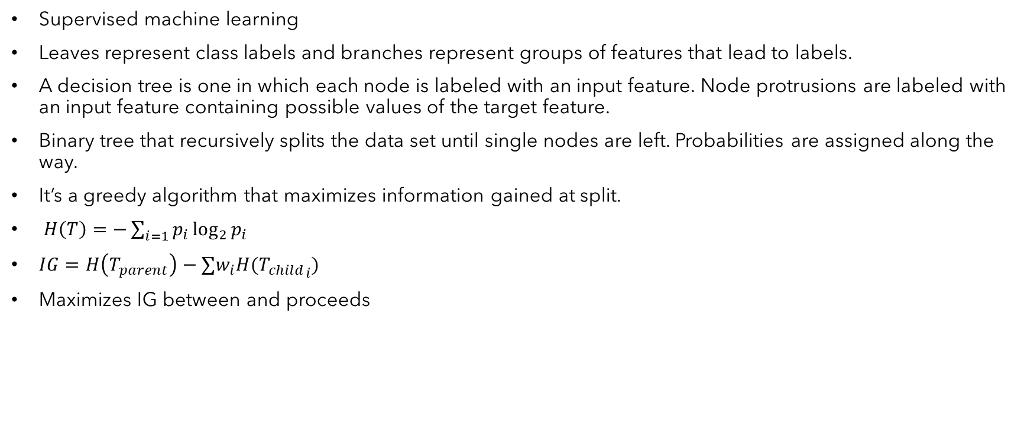
Decision trees
Supervised machine learning
Leaves represent class labels and branches represent groups of features that lead to labels.
A decision tree is one in which each node is labeled with an input feature. Node protrusions are labeled with an input feature containing possible values of the target feature.
Binary tree that recursively splits the data set until single nodes are left. Probabilities are assigned along the way.
It’s a greedy algorithm that maximizes information gained at split.
$H\left(T\right)=−\sum_{i=1}{p_{i}\log_{2}{p_{i}}}$
$IG=H\left(T_{parent}\right)−∑w_{i}H({T_{child}}_{i})$
Maximizes IG between and proceeds
Notes:
Entropy is used to describe the state of each decision node. If entropy is high then we don’t really know what the state of the node is. If entropy is low, then we are more certain about the observations of the node, so the decision is easier to make given the decision condition. The tree is randomly picking classes and their labels, and is iterating until its right basically.

Slide 16
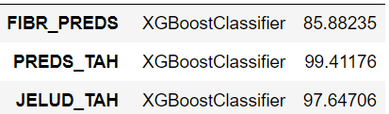
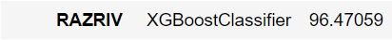
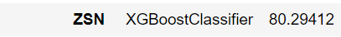
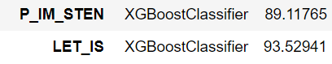
Winner winner chicken dinner XGBoost classifier
Stands for “Extreme Gradient Boosting.”
Good for missing data (had to impute anyway to run other models so it wasn’t used for this purpose)
Automatic feature selection
Implementation of gradient boosted decision trees.
Gradients, Hessians, so much scary math. Let's not give ourselves a headache! ☺
Its Newton-Raphson + log odds at the end of the day.
Regarding the data, it seems that XGBoost is good at predicting all the response variables, usually with high accuracy.
Diagnosing overfit for each model would be extremely time consuming. There are 72 models with their own plots!
Notes:
Like ridge regression in that we are minimizing the loss function which is the sum of square residuals plus a penalty or regularization term. The essence of XGB is that we are now taking that loss function and minimizing it using a 2nd
Order Taylor approximation. Plug in residuals divided by previous probability plus regularization term to get the optimal output value. It uses this to compare similarity scores and make a decision at the nodes.
The plots here would be ugly tree diagrams as in decision trees. Need to be cautious about overfitting on XGBoost models. Some things that control overfitting for these models is:
Training with more samples
2. reduce number of features
Reduce the maximum depth (essentially preventing it from memorizing itself)
Increase minimum sample at the level of leaves.

Slide 17
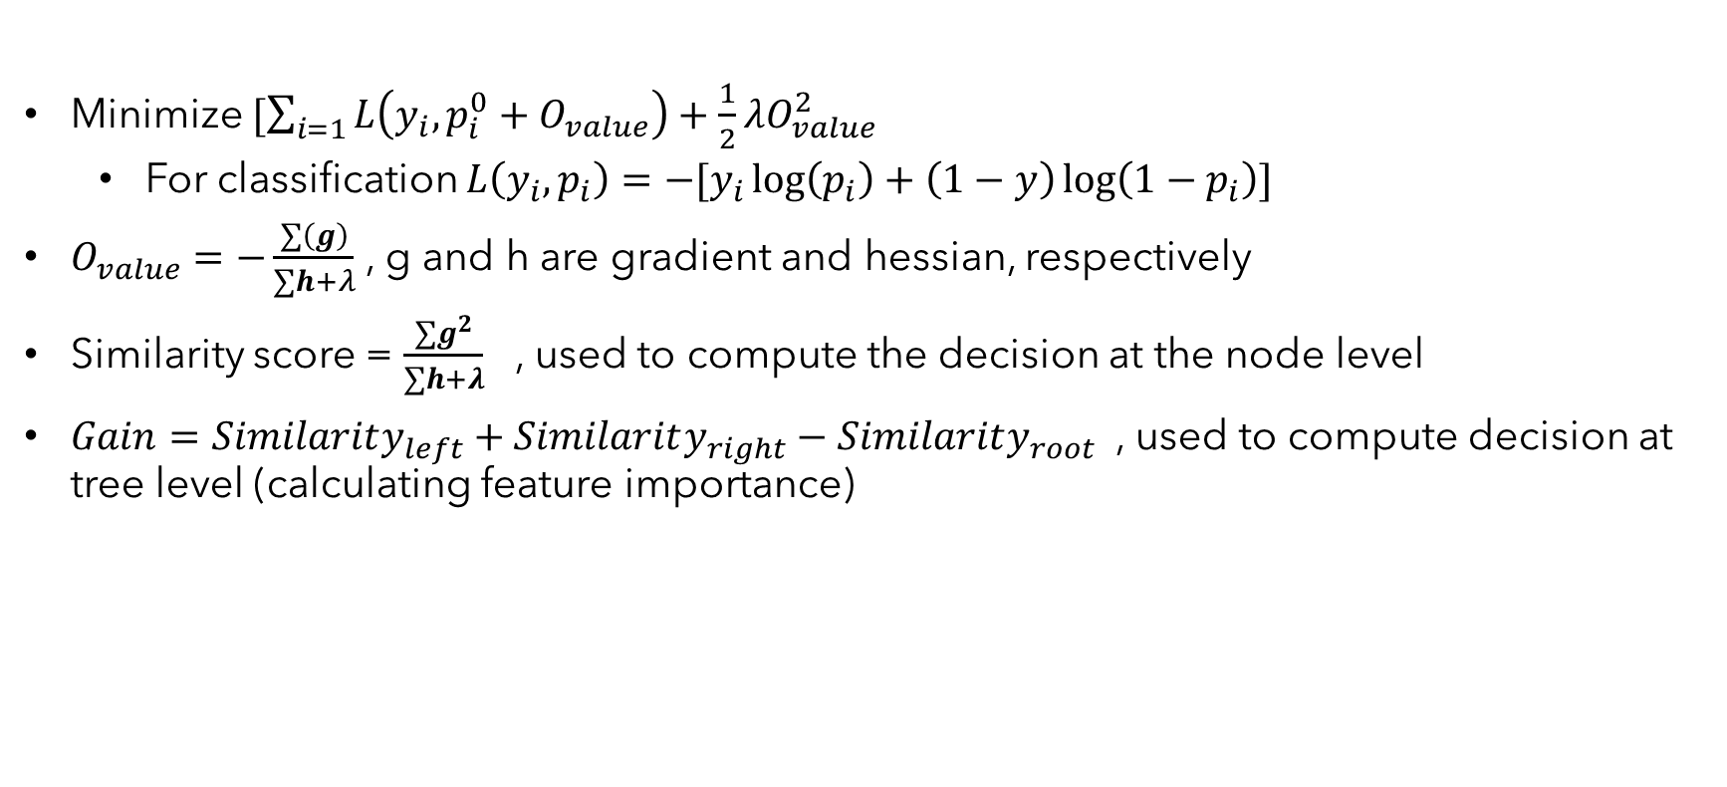
Xgb details
Minimize $[\sum_{i=1}{L\left(y_{i},p_{i}^{0}+O_{value}\right)+\frac{1}{2}λO_{value}^{2}}$
For classification $L\left(y_{i},p_{i}\right)=−[y_{i}\log\left(p_{i}\right)+\left(1−y\right)\log\left(1−p_{i}\right)]$
$O_{value}=−\frac{∑\left(g\right)}{∑h+λ}$ , g and h are gradient and hessian, respectively
Similarity score = $\frac{∑g^{2}}{∑h+λ}$ , used to compute the decision at the node level
$Gain=Similarity_{left}+Similarity_{right}−Similarity_{root}$ , used to compute decision at tree level (calculating feature importance)

Slide 18
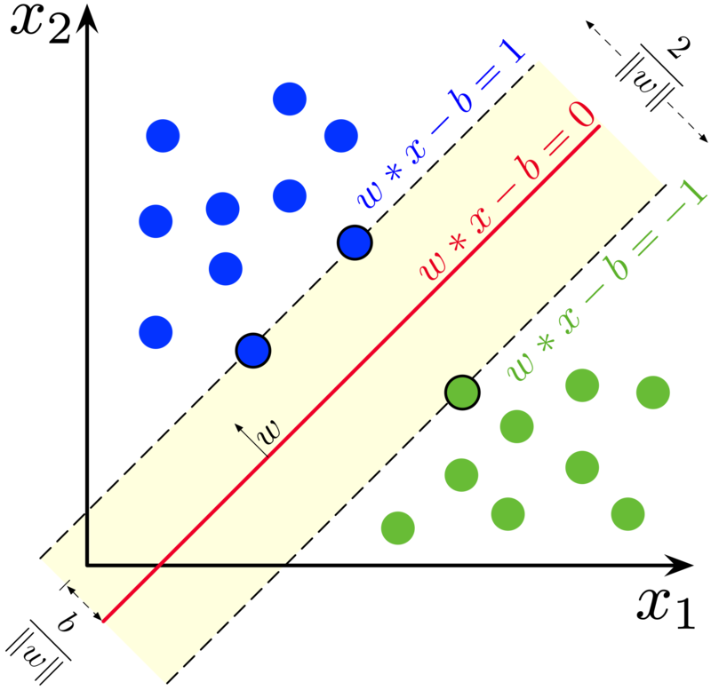
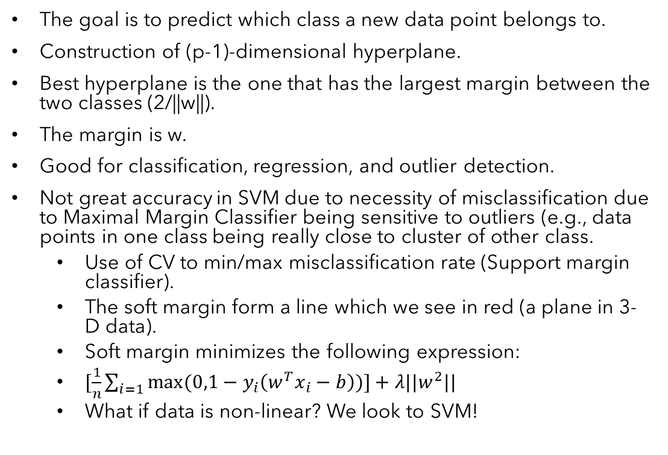
SUPPORT VECTOR classifier and MACHINE
The goal is to predict which class a new data point belongs to.
Construction of (p-1)-dimensional hyperplane.
Best hyperplane is the one that has the largest margin between the two classes (2/||w||).
The margin is w.
Good for classification, regression, and outlier detection.
Not great accuracy in SVM due to necessity of misclassification due to Maximal Margin Classifier being sensitive to outliers (e.g., data points in one class being really close to cluster of other class.
Use of CV to min/max misclassification rate (Support margin classifier).
The soft margin form a line which we see in red (a plane in 3-D data).
Soft margin minimizes the following expression:
$[\frac{1}{n}\sum_{i=1}{max⁡(0,1−y_{i}\left(w^{T}x_{i}−b\right))]+λ||w^{2}||}$
What if data is non-linear? We look to SVM!
Notes:
The shortest distance between the observations and the threshold is called the margin. Support vector classifiers are an extension of support margin classifiers. SVCs are less sensitive to individual data.

Slide 19
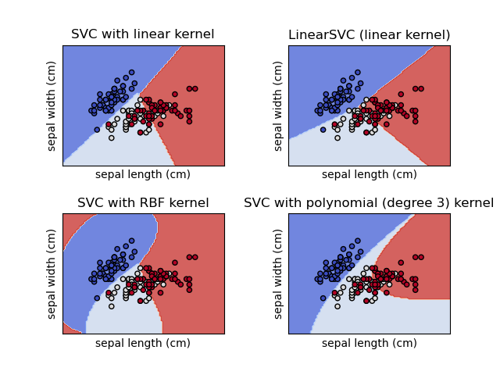
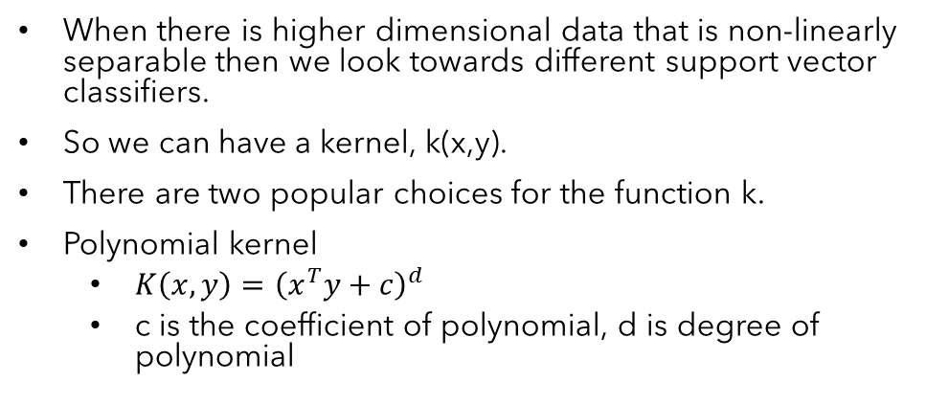
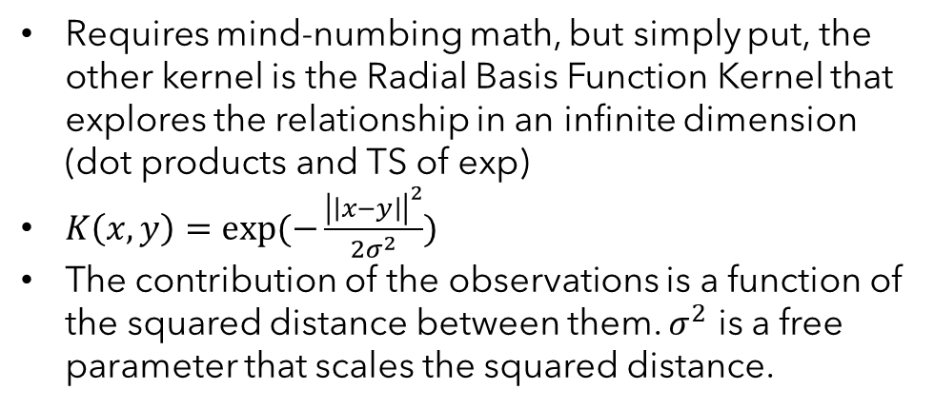
Support vector machine and kernel transformations
When there is higher dimensional data that is non-linearly separable then we look towards different support vector classifiers.
So we can have a kernel, k(x,y).
There are two popular choices for the function k.
Polynomial kernel
$K\left(x,y\right)={\left(x^{T}y+c\right)}^{d}$
c is the coefficient of polynomial, d is degree of polynomial
Requires mind-numbing math, but simply put, the other kernel is the Radial Basis Function Kernel that explores the relationship in an infinite dimension (dot products and TS of exp)
$K\left(x,y\right)=exp⁡(−\frac{{\left|\left|x−y\right|\right|}^{2}}{2σ^{2}})$
The contribution of the observations is a function of the squared distance between them. $σ^{2}$ is a free parameter that scales the squared distance.
Notes:
The computation of the kernel function is the high-dimensional relationship between observations that are relatively close or far away from each other. When the data are close to each other then the value of K is near zero. SVC is support vector classifier.

Slide 20
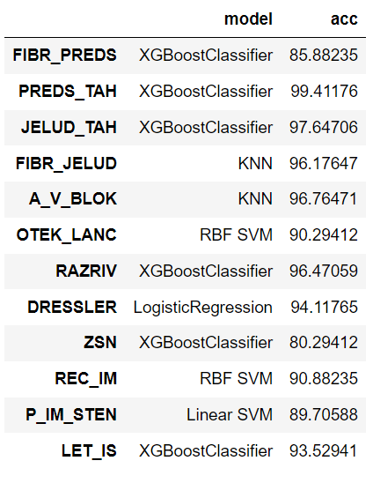
Model performance summary
Notes:
I didn’t include AUC curves for all of these because there is 72 of them.

Slide 21
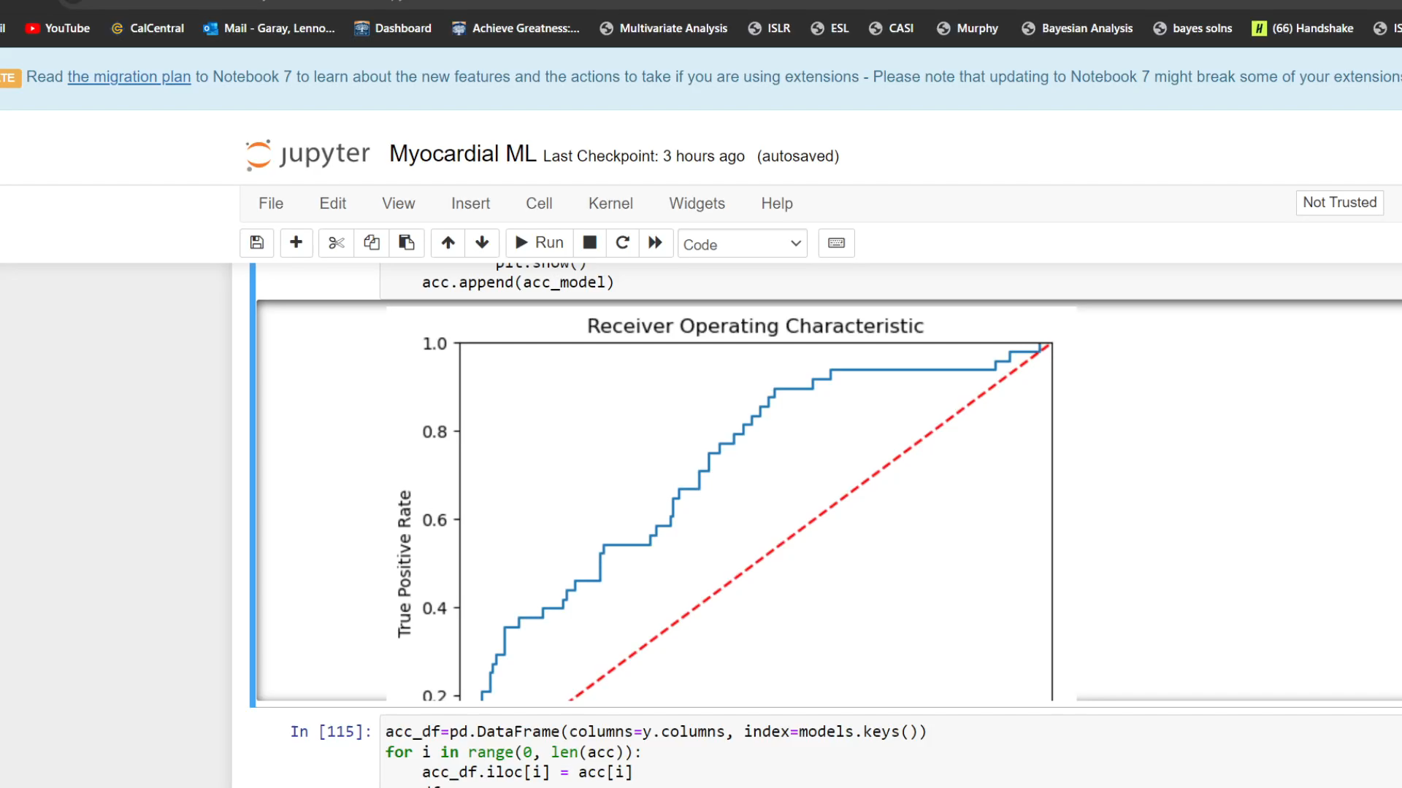

Slide 22
Conclusions
We succeeded in our task of classifying the response variables for complications regarding myocardial infarction.
Most models had above 90% classification accuracy.
Visualizing this data and models is a difficult challenge, but anyone better than me at coding could do this much faster than me.
Feature importance was abstracted through model runs. All I looked for in this project was accuracy.
It would be interesting to explore risk factors for these complications.
Diet, exercise, genome analysis
This dataset is an okay candidate for survival analysis over 3 days
The models were sensitive to proportion of observations (e.g., supraventricular tachycardia)

Slide 23
Thanks for listening ☺

Slide 24
References
Mechanic OJ, Gavin M, Grossman SA. Acute Myocardial Infarction. [Updated 2023 Sep 3]. In: StatPearls [Internet]. Treasure Island (FL): StatPearls Publishing; 2023 Jan-.
Ornato JP, Hand MM. Warning signs of a heart attack. Circulation [J]. 2014 Mar 18; 129(11):e393-5.
https://www.cdc.gov/heartdisease/facts.htm, 2020
S.E. Golovenkin, Alexander GorbanAlexander Gorban, Evgeny MirkesEvgeny Mirkes, V.A. Shulman, D.A. Rossiev, P.A. Shesternya, S.Yu. Nikulina, Yu.V. Orlova, M.G. Dorrer 2020
Get an Overview of Heart Attack. (n.d.). CUSABIO. https://www.cusabio.com/cardiovascular/Heart-Attack.html
Myocardial infarction complications Database. (2020). Leicester.figshare.com. https://doi.org/10.25392/leicester.data.12045261.v3
Ojha, N., & Dhamoon, A. S. (2022). Myocardial Infarction. National Library of Medicine; StatPearls Publishing. https://www.ncbi.nlm.nih.gov/books/NBK537076/
Steeg, G. V., & Galstyan, A. (2015, January 30). Maximally Informative Hierarchical Representations of High-Dimensional Data. ArXiv.org. https://doi.org/10.48550/arXiv.1410.7404

Slide 25
Questions?

